Slide 1
Automatic Start and Stop of EC2 instances using AWS lambda
NAME:Khasab ArshadBasha

Slide 2
Introdution:
This project, "Automate Start-Stop of EC2 Instances Using AWS Lambda", aims to solve this problem by leveraging serverless automation. By using AWS Lambda, Amazon EventBridge (formerly CloudWatch Events), and EC2 instance tagging, we create a system that automatically starts EC2 instances at the beginning of the day and stops them at the end. This helps to ensure that compute resources are only active when required, leading to substantial cost savings.

Slide 3
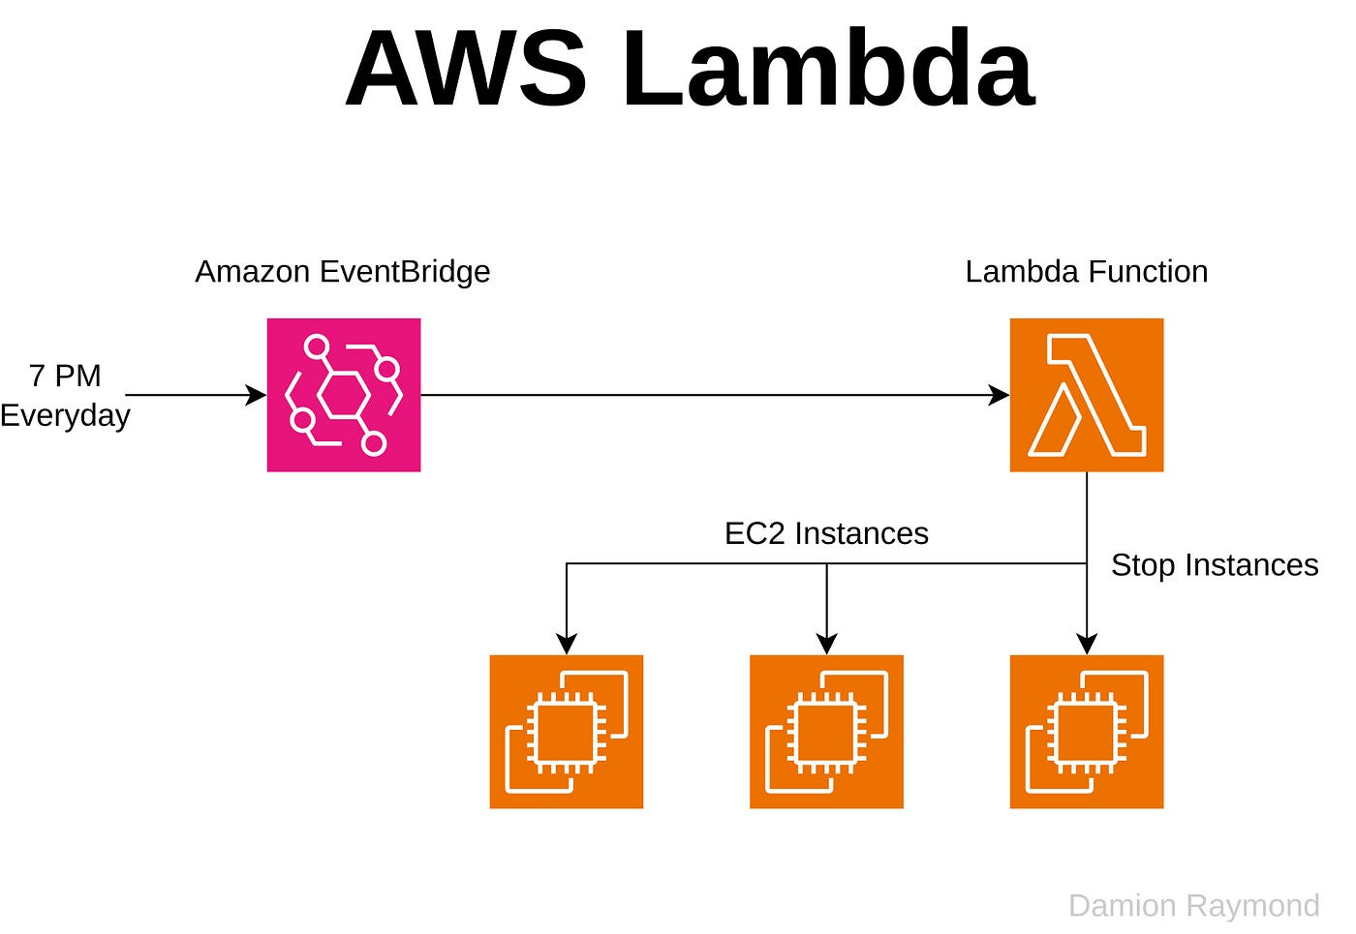

Slide 4
Required service
Amazon EC2
AWS Lambda
IAM Role (With EC2 permissions)
Amazon cloudwatch events

Slide 5
What is the use of this project?
1. Save MoneyEC2 instances cost money when they are running, even if no one is using them.Automatically stopping instances during non-working hours (like nights or weekends) avoids unnecessary charges.Automatically starting them during work hours ensures they are available when needed.
✅ 2. AutomationNo manual intervention needed.You can schedule start/stop times using CloudWatch Events (EventBridge) + Lambda.Useful for environments where usage is predictable (e.g., development or testing).
✅ 3. Use CasesDevelopment servers (e.g., turn off after 7 PM and turn on at 9 AM).Training labs or student environments.Testing environments used during the day only.Temporary workloads or demo environments.
✅ 4. ExampleAction Time DescriptionStop 7 PM Automatically stop instance to save cost.Start 1 pM Automatically start instance for use.

Slide 6
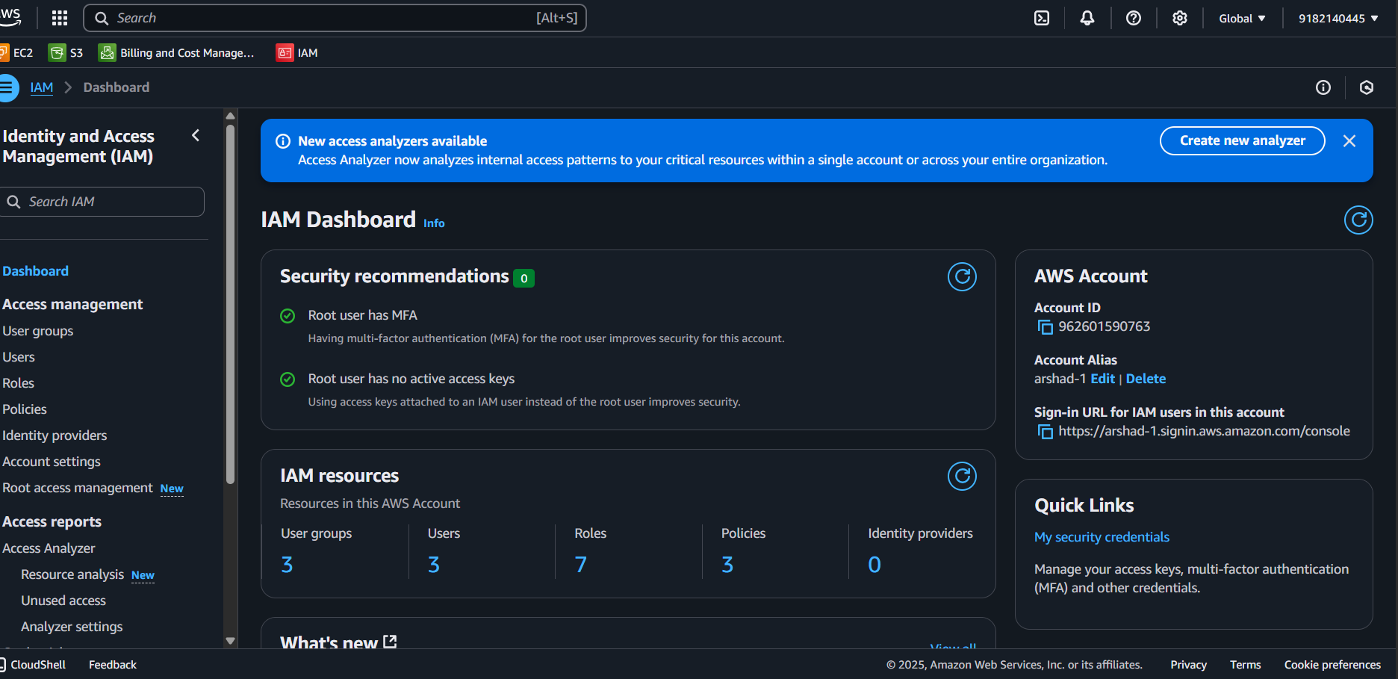

Slide 7
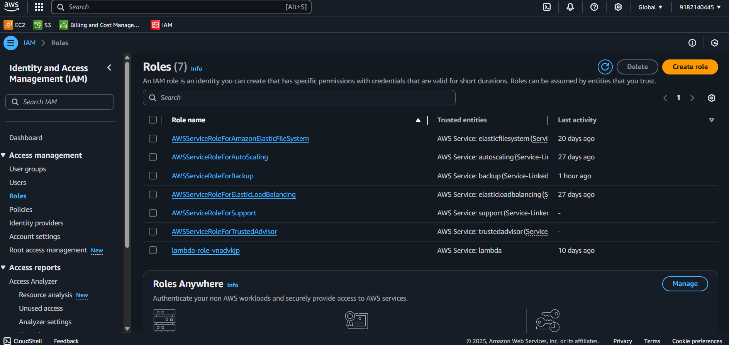
Select the Amazon-fullaccess-role

Slide 8
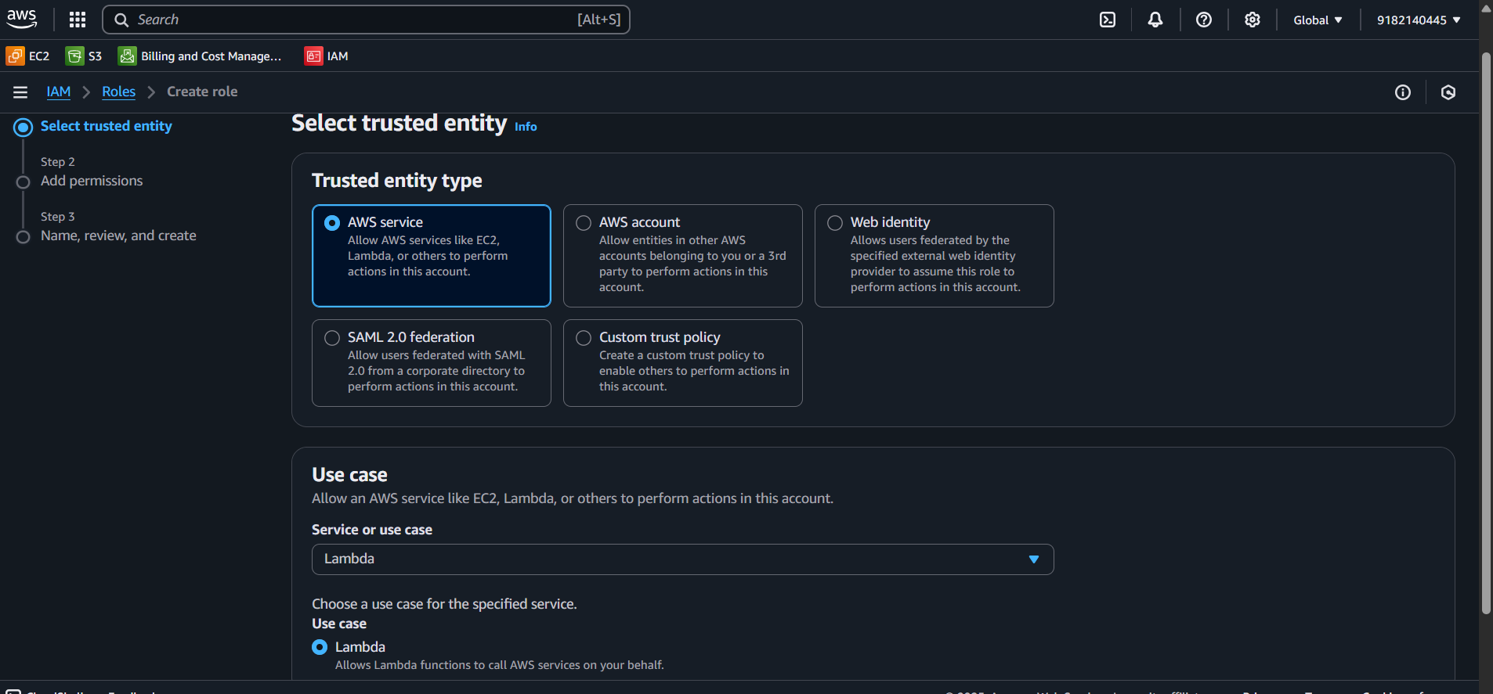

Slide 9
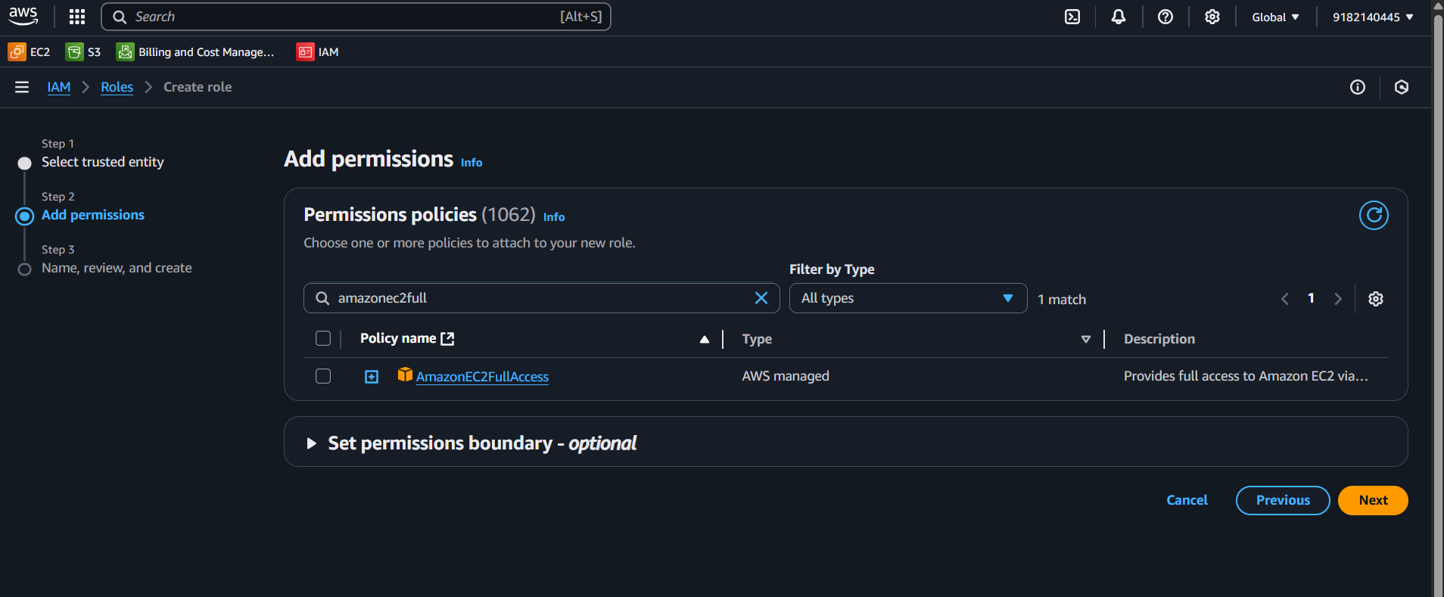

Slide 10
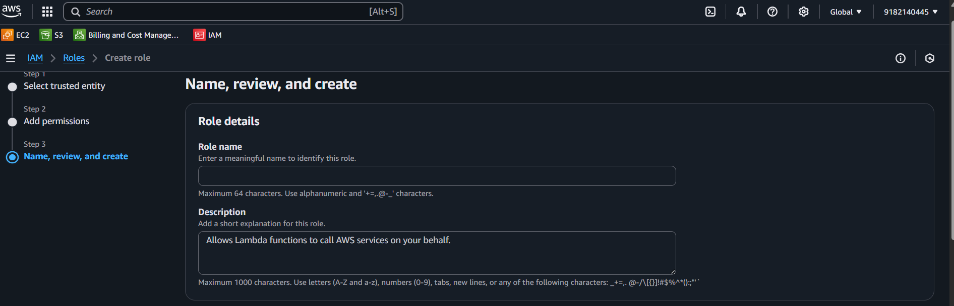

Slide 11
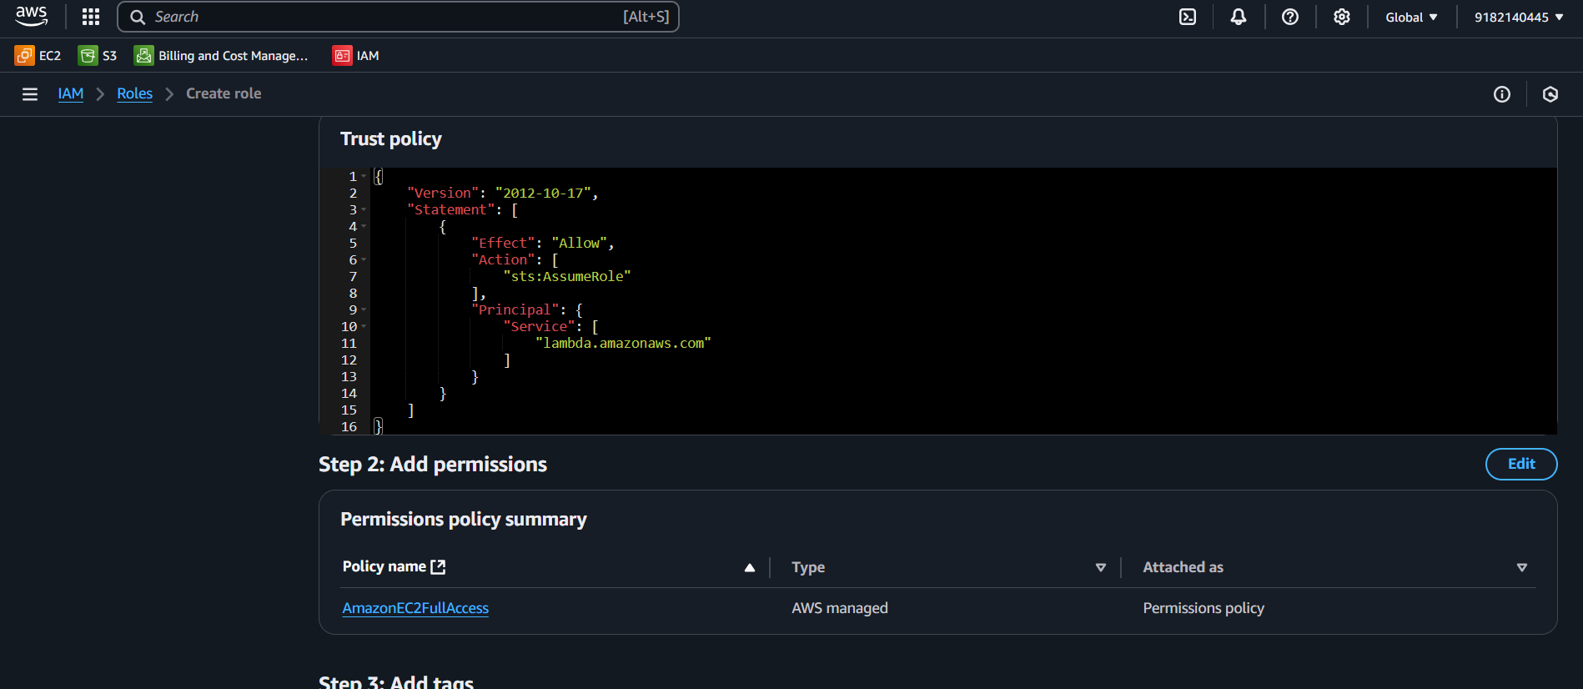

Slide 12
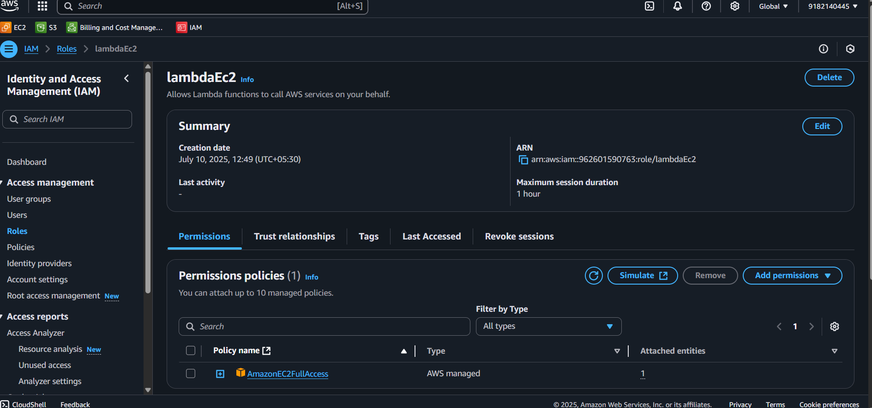

Slide 13
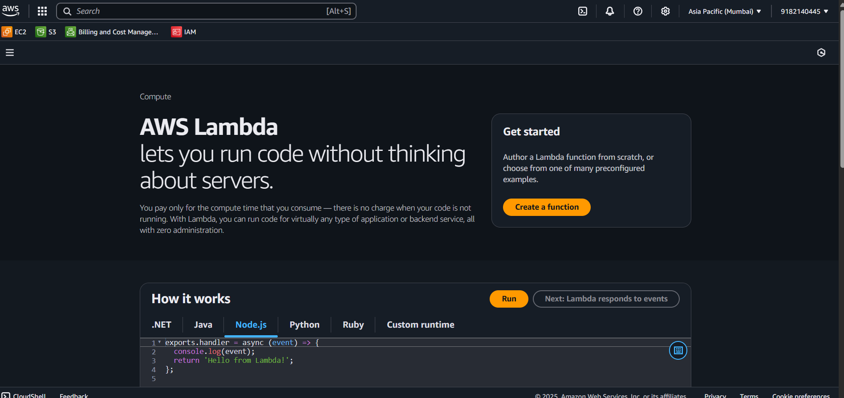

Slide 14
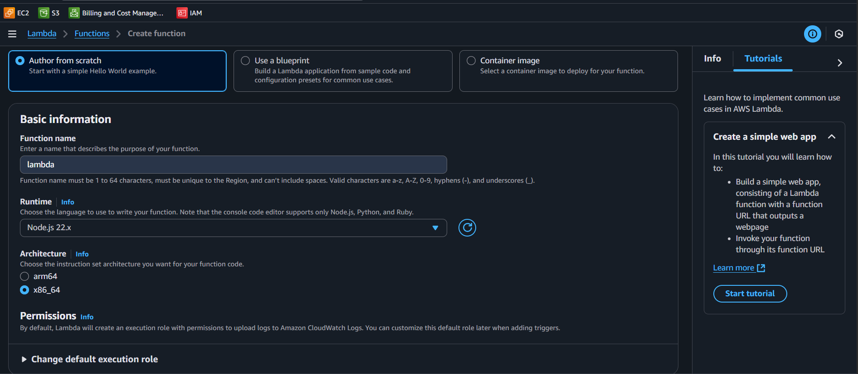

Slide 15
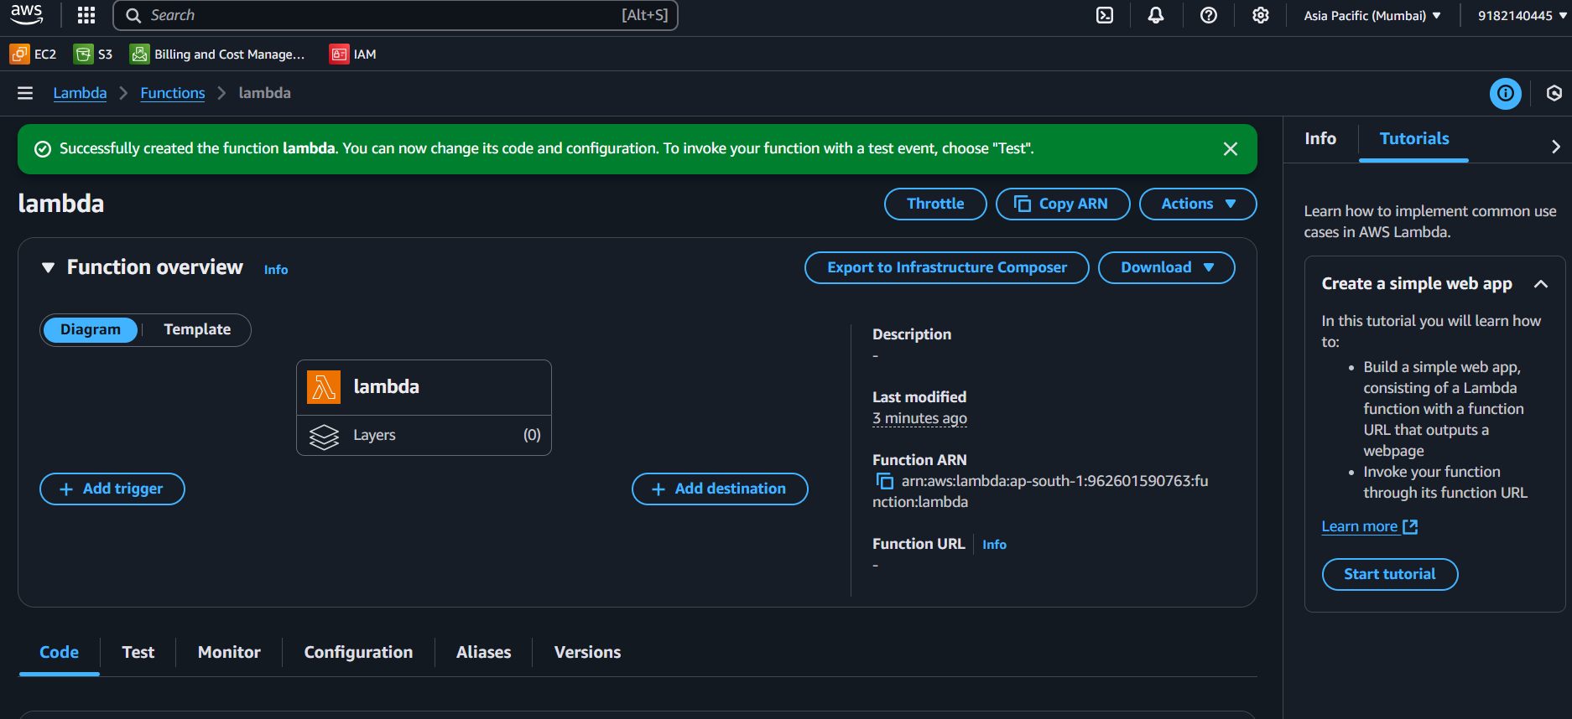

Slide 16
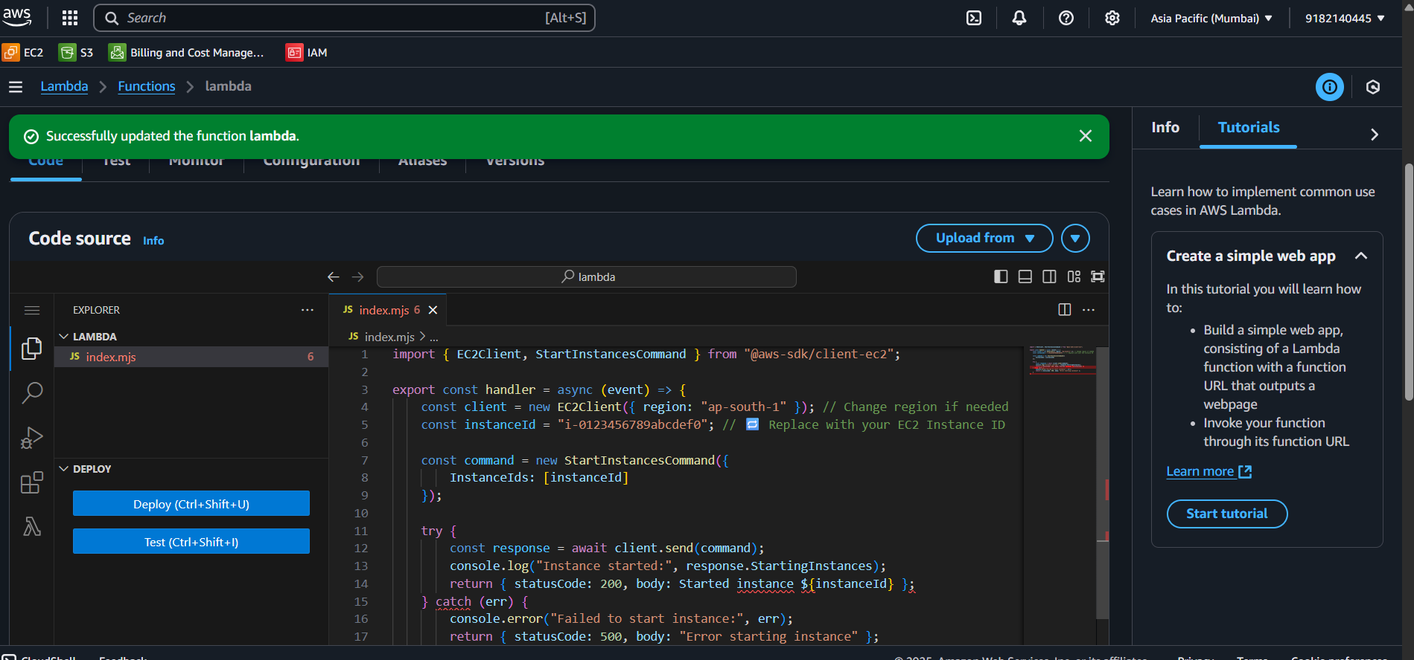

Slide 17
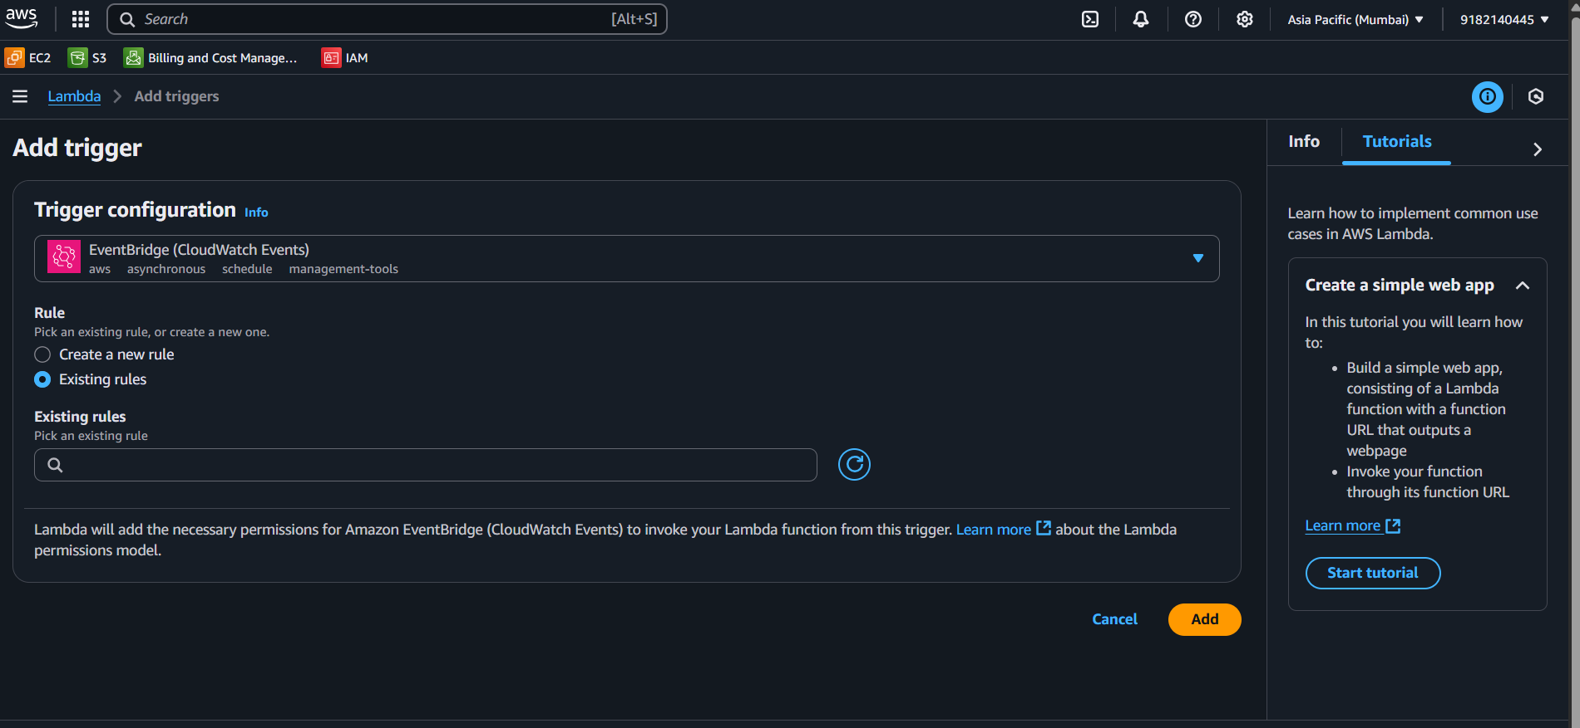

Slide 18
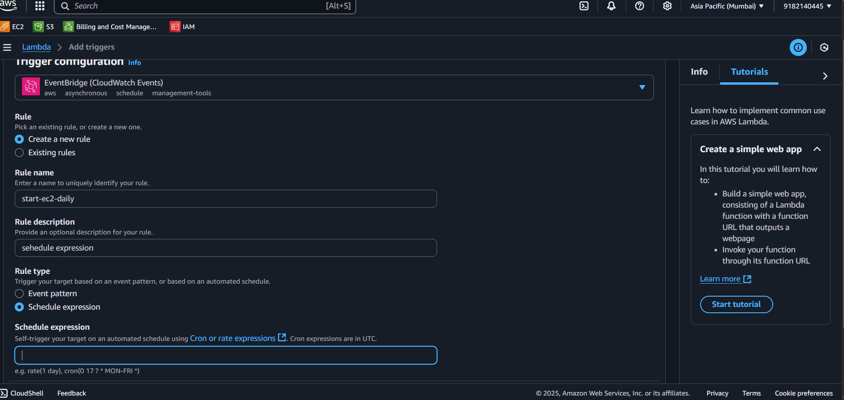

Slide 19
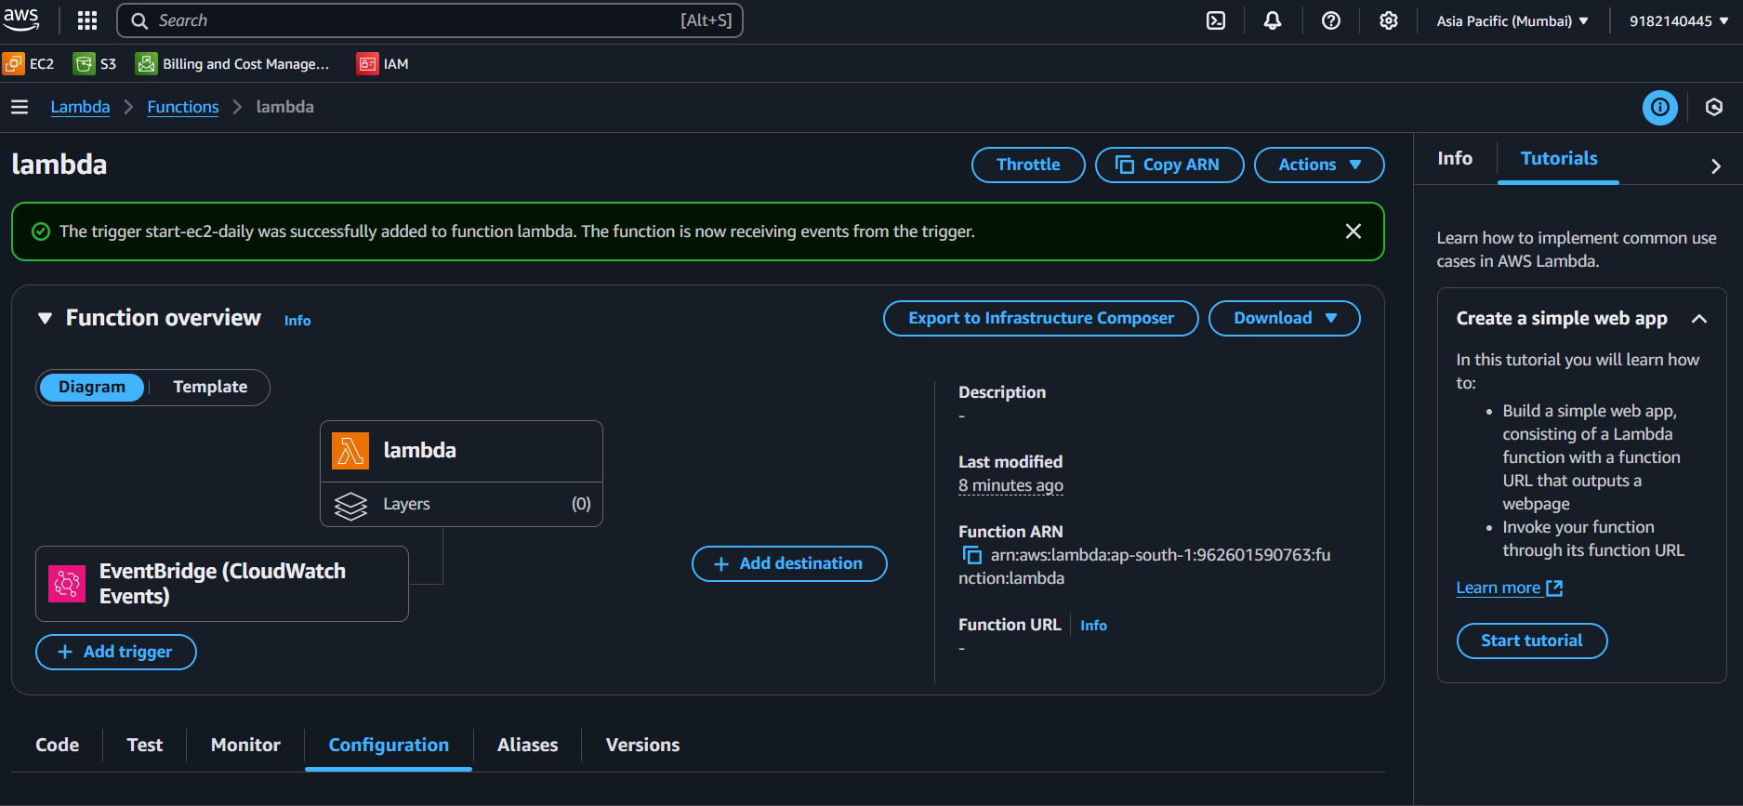

Slide 20
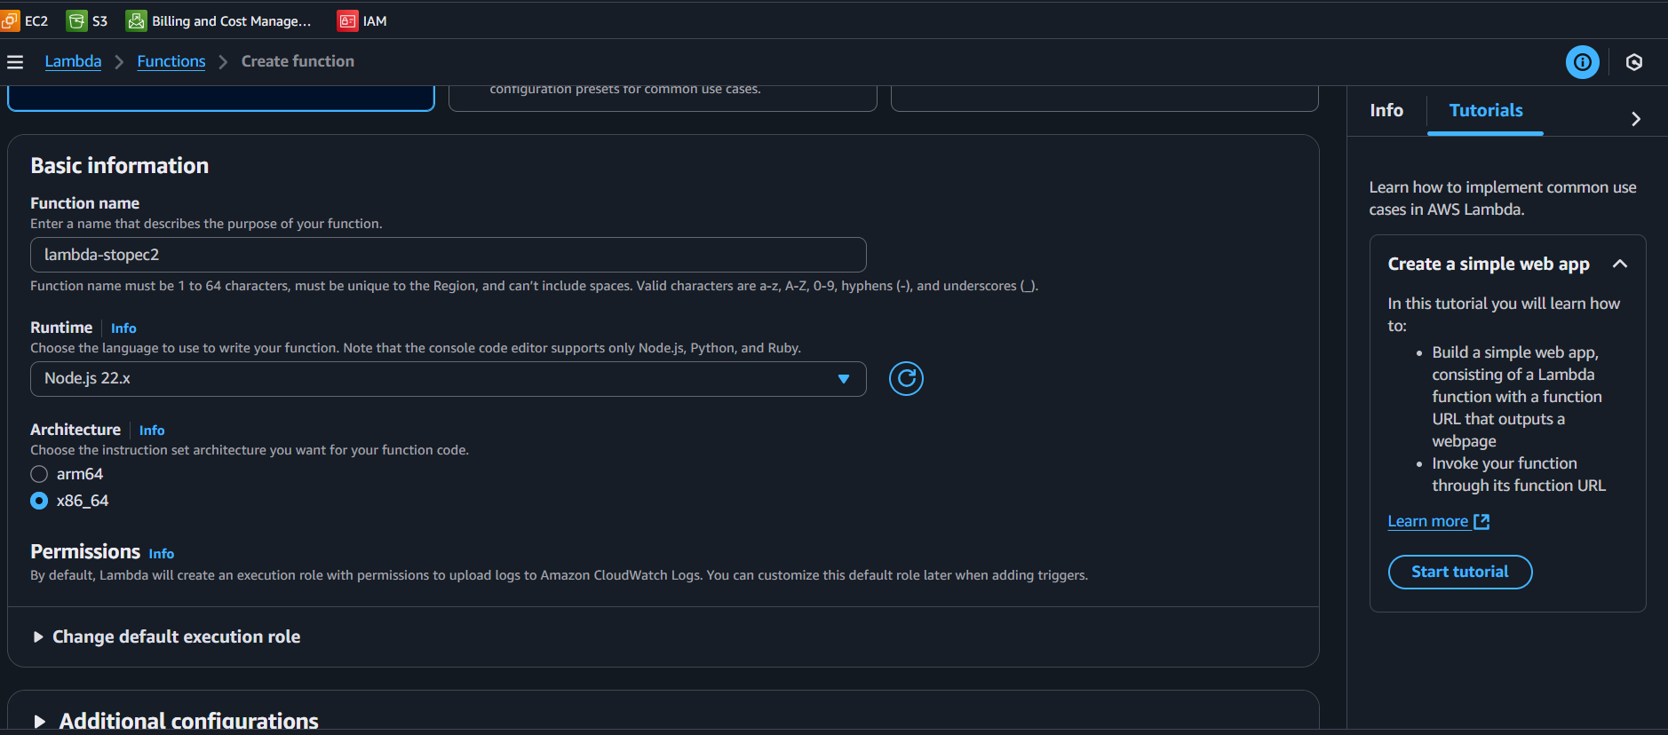

Slide 21
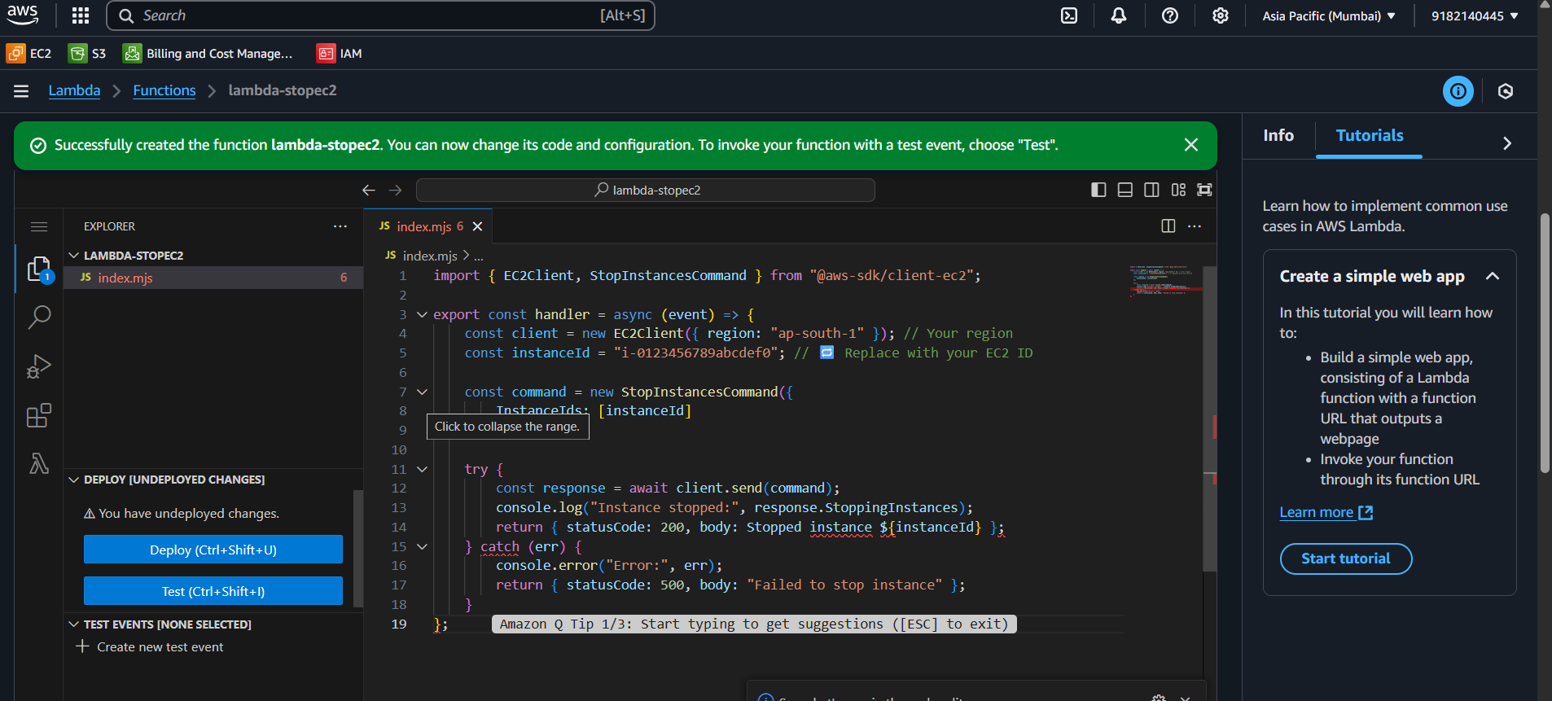

Slide 22
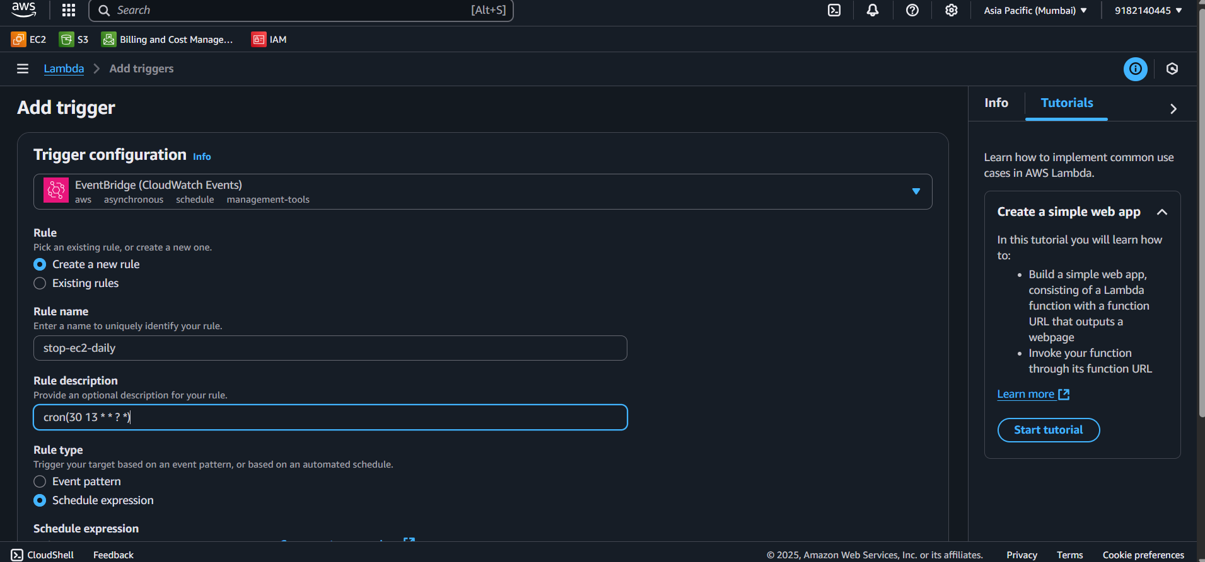

Slide 23
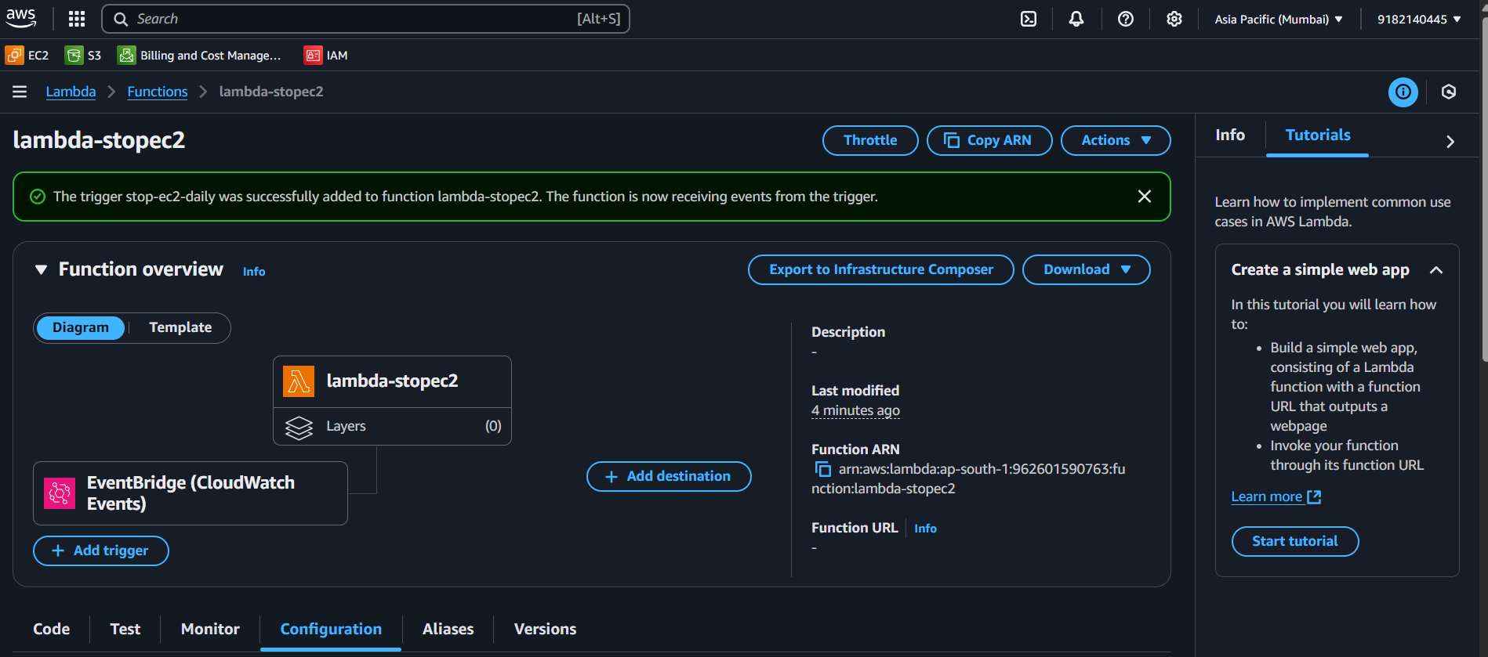

Slide 24
Node.js code to start the ec2 instance
import { EC2Client, StartInstancesCommand } from "@aws-sdk/client-ec2";export const handler = async (event) => { const client = new EC2Client({ region: "ap-south-1" }); // Change region if needed const instanceId = "i-0123456789abcdef0"; // 🔁 Replace with your EC2 Instance ID const command = new StartInstancesCommand({ InstanceIds: [instanceId] }); try { const response = await client.send(command); console.log("Instance started:", response.StartingInstances); return { statusCode: 200, body: Started instance ${instanceId} }; } catch (err) { console.error("Failed to start instance:", err); return { statusCode: 500, body: "Error starting instance" }; }};

Slide 25
Node.js code to stop the instance
import { EC2Client, StopInstancesCommand } from "@aws-sdk/client-ec2";export const handler = async (event) => { const client = new EC2Client({ region: "ap-south-1" }); // Your region const instanceId = "i-0123456789abcdef0"; // 🔁 Replace with your EC2 ID const command = new StopInstancesCommand({ InstanceIds: [instanceId] }); try { const response = await client.send(command); console.log("Instance stopped:", response.StoppingInstances); return { statusCode: 200, body: Stopped instance ${instanceId} }; } catch (err) { console.error("Error:", err); return { statusCode: 500, body: "Failed to stop instance" }; }};

Slide 26
By Following steps: we will create a scheduled programming for EC2 to start and stop. End ResultsEC2 instances with the tag AutoStartStop = true will start at 7 AM UTC.And will stop at 1 PM UTC.Everything runs serverless and hands-free via AWS Lambda and EventBridge.
Thank you
Khasab Arshadbasha

